Slide 1
Page
Home
About
Project
Contact
01
Mental Health in Tech (2014–2023)
Data Analysis & Insights
Read More
Presented By :
Mariam Raafat Mohamed

Slide 2
Page
Home
About
Project
Contact
02
Table of Contents
01.
Introduction
02.
Problem Statement
03.
Objective of Analysis
04.
Data Overview
05.
Cleaning & Preprocessing
06.
Key Insight
07.
Conclusion & Recommendations
Presented By :
Mariam Raafat Mohamed

Slide 3
Page
Home
About
Project
Contact
03
Introduction
Example 01
Mental health is as important as physical health
What is mental health and why it matters
Example 02
Influences productivity, relationships, and quality of life
The tech sector is fast-paced and mentally demanding.
Mental health awareness has become crucial over the years.
Dataset used:
OSMI Mental Health in Tech Survey
(2014–2023)
Example 03
Good mental health promotes overall well-being
Read More
Presented By :
Mariam Raafat Mohamed

Slide 4
Page
Home
About
Project
Contact
04
Problem Statement
Importance of Mental Health
Example 01
To investigate how demographic, work-related, social, and organizational factors can be related to mental health problems.
Example 02
Given this, the goal is to develop a predictive model that indicates whether a person might need medical help.
Presented By :
Mariam Raafat Mohamed

Slide 5
Page
Home
About
Project
Contact
05
Objective of Analysis
Understanding patterns and shifts in:
Example 01
Example 03
Mental health awareness
Workplace support
Example 02
Example 04
Gender and age effects
Yearly trends
Presented By :
Mariam Raafat Mohamed

Slide 6

Page
Home
About
Project
Contact
06
Data Overview
Total Responses: ~4,500+
Years Covered: 2014 to 2023
Key Columns:
Age, Gender, Country, Work interference, Mental health Treatment, Benefits availability
Presented By :
Mariam Raafat Mohamed

Slide 7
Page
Home
About
Project
Contact
07
Cleaning & Preprocessing
Example 02
Standardized gender values
Example 01
Removed outliers (age < 18 or > 80)
Example 03
Unified column names across years
Read More

Slide 8
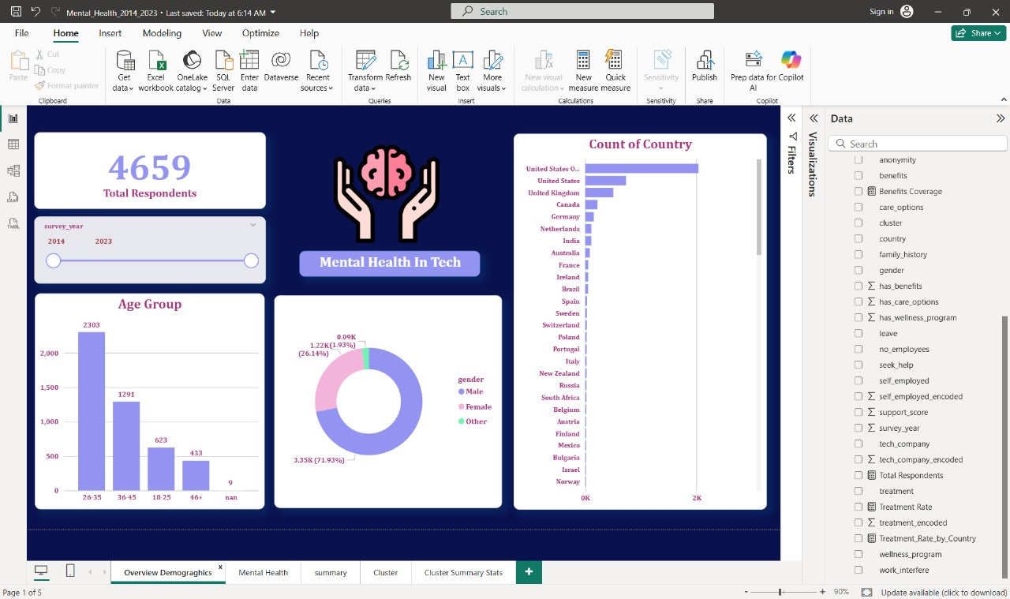
Page
Home
About
Project
Contact
08
Key Insight:
1 — Age & Mental Health
Majority of affected respondents: Age group 25–35
Presented By :
Mariam Raafat Mohamed

Slide 9
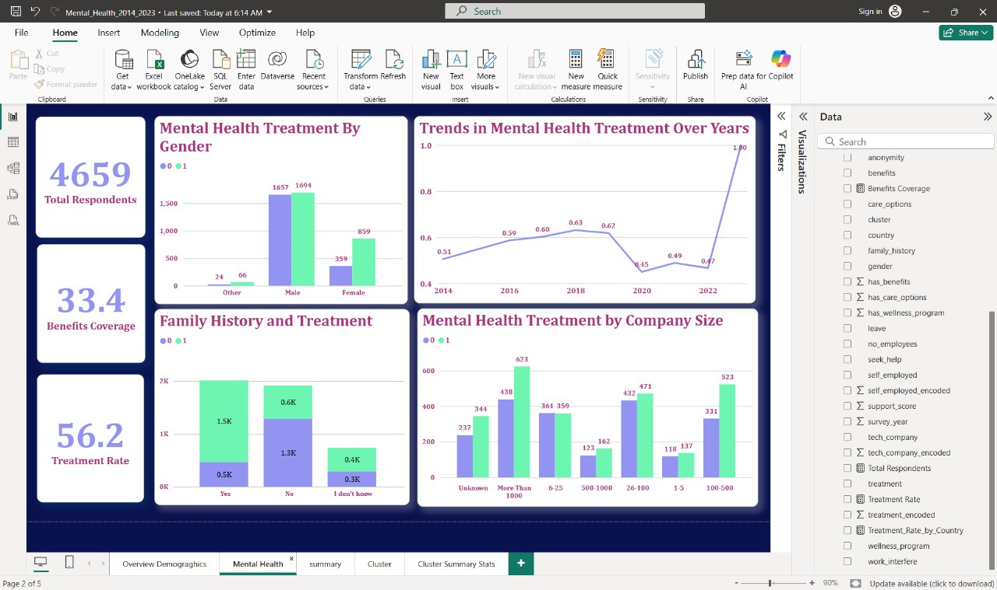
Page
Home
About
Project
Contact
05
Key Insight:
2- Gender Differences
Presented By :
Mariam Raafat Mohamed

Slide 10
Page
Home
About
Project
Contact
10
Conclusion & Recommendations
Mental health is gaining visibility but stigma still exists
Recommendations:
Anonymous support systems
Manager training on mental health
Inclusive, flexible workplace policies
Presented By :
Mariam Raafat Mohamed

